Slide 1
PYTHON: DEEP LEARNING WITH TENSORFLOW
MARCH 4th && 5th, 2019

Slide 2
Workshop Resources
All materials, including these slides and notebooks are available here:
https://github.com/allemanau/NUIT_tensorflow/

Slide 3
What is deep learning? (A VERY BRIEF AND INCOMPLETE HISTORY)

Slide 4
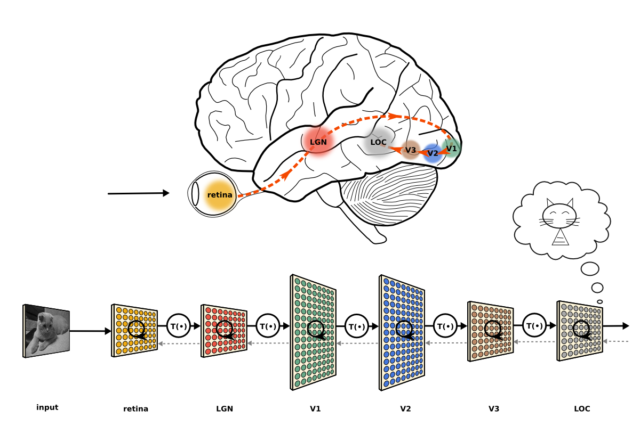
A BRIEF AND INCOMPLETE HISTORY
Goal: emulate human cognition -- learn abstract concepts from sensory inputs.
Input: our eyes detect a collection of shapes, shadows, curves, textures, and colors.
Results: the brain recognizes a cat.

Slide 5
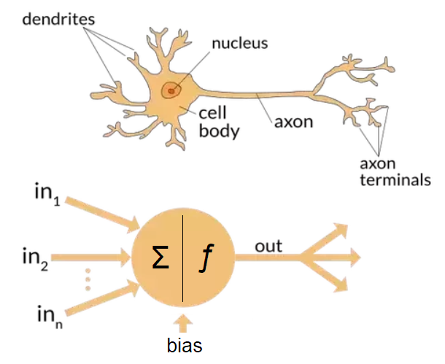
A BRIEF AND INCOMPLETE HISTORY
1943: logical (AND, OR, …) model of neuron activity developed at UIC/UChicago (McCulloch & Pitts)
Dendrites: accept input/signals from other neurons
Nucleus: aggregates and transforms signal
Axon/terminals: pass signal onto next neuron or receptor

Slide 6
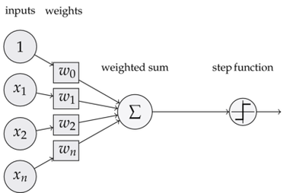
A BRIEF AND INCOMPLETE HISTORY
1958: perceptron binary classifier developed at Cornell Aeronautical Laboratory (Rosenblatt)
1965: multilayer perceptron networks, inefficient to train
(Ivakhnenko, Lapa)

Slide 7

A BRIEF AND INCOMPLETE HISTORY
1975: backpropagation algorithm to train multi-layer networks devised (Werbos)
1986: importance of backpropagation to neural net training illuminated (Hinton et al)

Slide 8
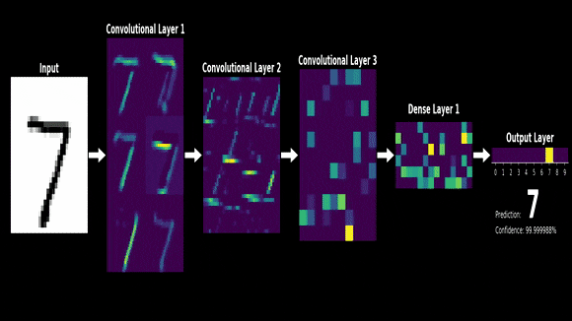
A BRIEF AND INCOMPLETE HISTORY
1989: backpropagation used to train a convolutional neural net to recognize handwritten zip code digits (LeCun et al)

Slide 9
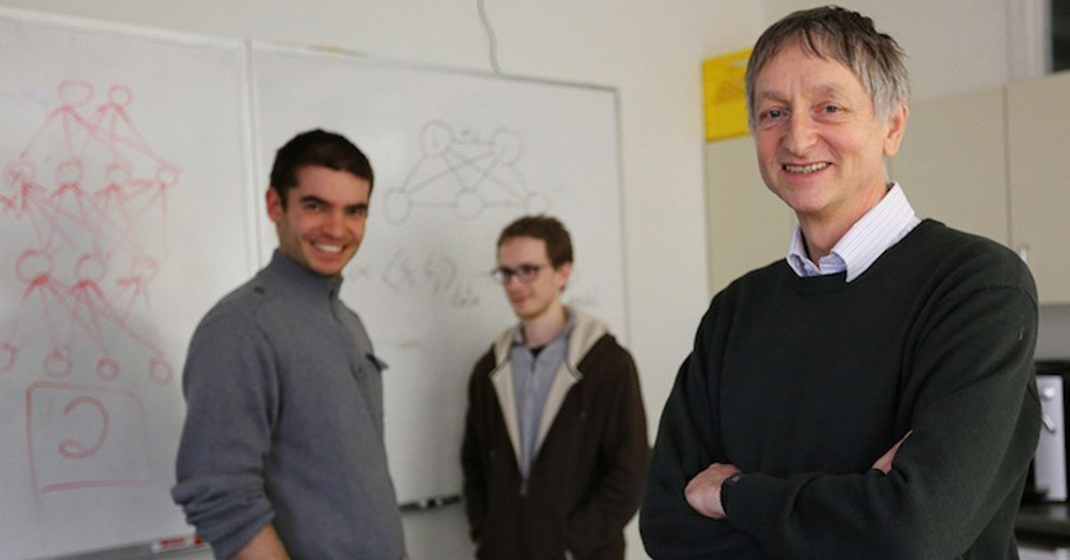
A BRIEF AND INCOMPLETE HISTORY
2009: ImageNet competition launched (more in a moment)
2012: AlexNet published, demonstrates power of deep neural networks and feasibility of large-scale model training via GPUs
Left to right: AlexNet architects Ilya Sutskever, Alex Krizhevsky, and Geoffrey Hinton (WIRED)

Slide 10
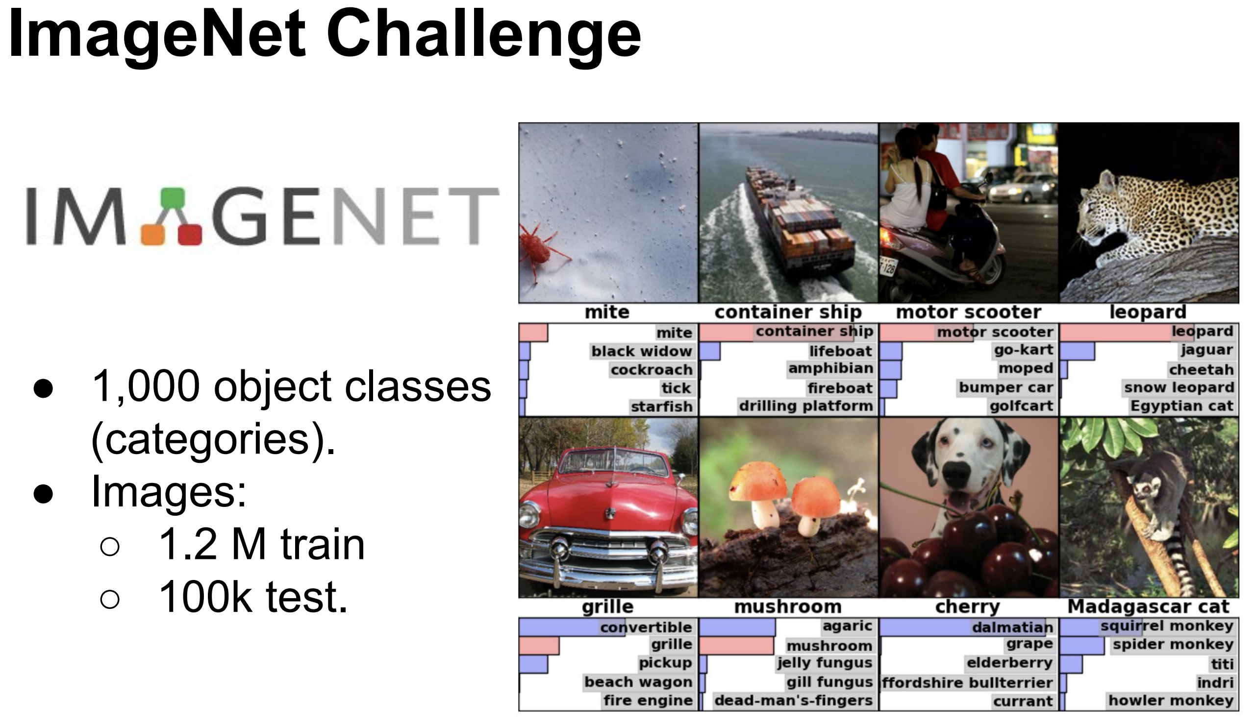

Slide 11
Alex Krizhevsky, Ilya Sutskever, & Geoffrey Hinton, 2012:
“We trained a large, deep convolutional neural network to classify the 1.2 million high-resolution images in the ImageNet LSVRC-2010 contest into the 1000 different classes…and achieved by far the best results ever reported.”
“We also entered a variant of this model in the ILSVRC-2012 competition and achieved a winning top-5 test error rate of 15.3%, compared to 26.2% achieved by the second-best entry”

Slide 12
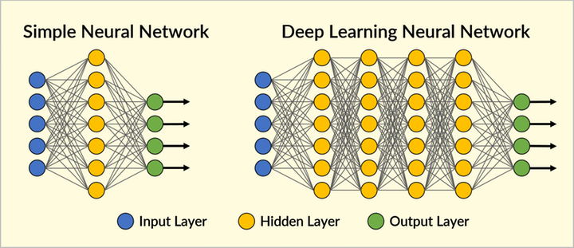
Deep learning = more layers = more complexity.

Slide 13
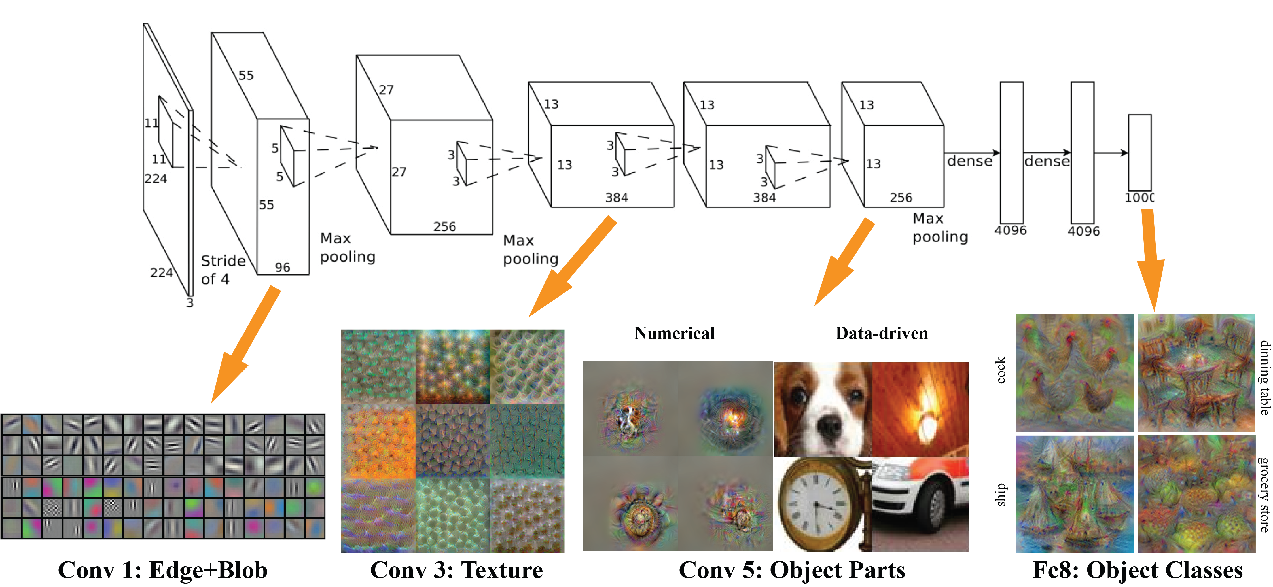
AlexNet image recognition deep learning model

Slide 14
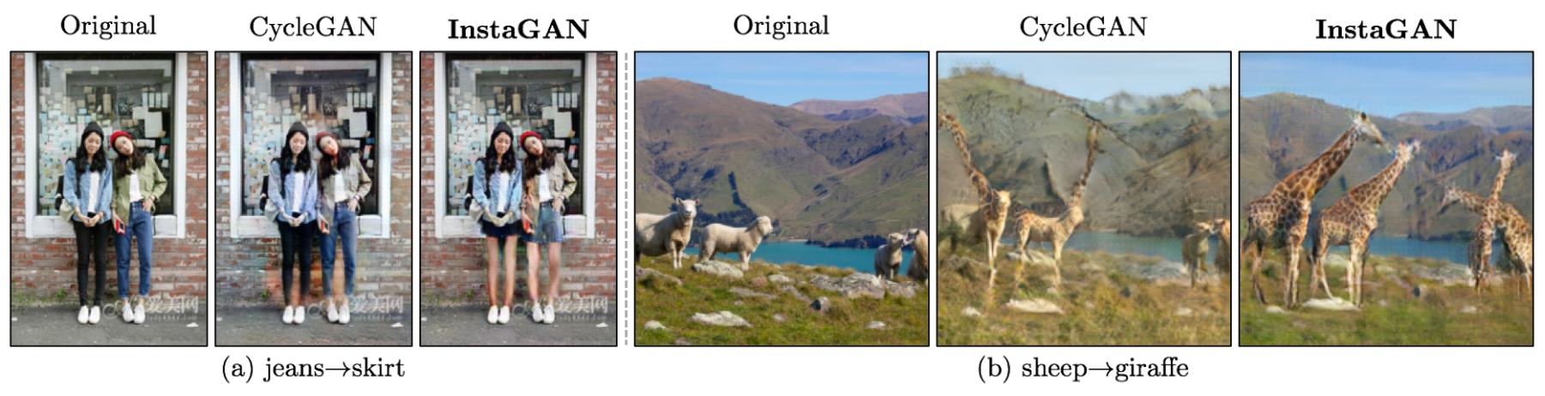
A BRIEF AND INCOMPLETE HISTORY
2014: Generative adversarial networks (GAN) pit two networks against each other – one tries to fool the other. The trained network can “create” unseen examples:

Slide 15
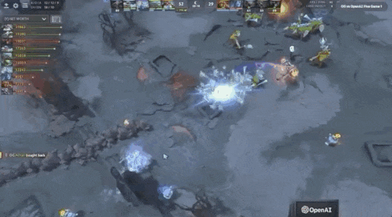
A BRIEF AND INCOMPLETE HISTORY
2016, 2017: AlphaGo Master beats the #1 ranked Go player in the world. Retires.
2019: OpenAI Five beats 2018 Dota 2 champions in a best-of-three series, won 38k of 42k online public matches over 4 days.

Slide 16


Slide 17
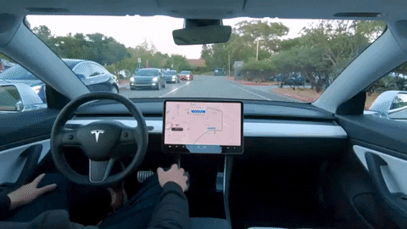

Slide 18





Assisted diagnosis
Drug discovery
Precision medicine
Mining genetic data
Imitation learning
Auto-translation
Multiple agents
Synthetic audio/video
Self-supervised learning
Code generation

Slide 19
LEARNING OBJECTIVES

Slide 20




Tools to build and train neural networks

Slide 21
Basics of architecture, training strategy, and evaluation

Slide 22
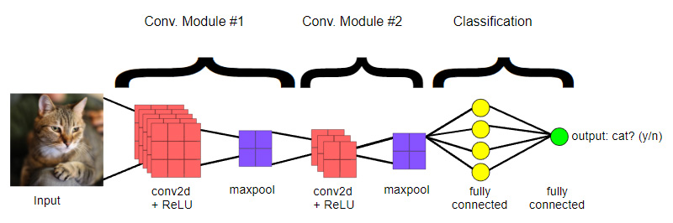
Special topics including convnets, data augmentation, (possibly) transfer learning

Slide 23
INTRODUCTIONS
Take a minute to introduce yourself to your neighbors:
What do you hope to learn?
How do you hope to apply DL to your work?
Read any good books lately? Binged any good series?

Slide 24
ORDER OF OPERATIONS
Deep learning
TensorFlow
Basic NN
CNN
Conclusion
Neural nets and deep learning

Slide 25
ORDER OF OPERATIONS
Deep learning
TensorFlow
Basic NN
CNN
Conclusion
Tensors and data flow in Python
Neural nets and deep learning

Slide 26
ORDER OF OPERATIONS
Deep learning
TensorFlow
Basic NN
CNN
Conclusion
Tensors and data flow in Python
Neural nets and deep learning
Operational neural net on MNIST

Slide 27
ORDER OF OPERATIONS
Deep learning
TensorFlow
Basic NN
CNN
Conclusion
Tensors and data flow in Python
CNN & data augmentation
Neural nets and deep learning
Operational neural net on MNIST

Slide 28
ORDER OF OPERATIONS
Deep learning
TensorFlow
Basic NN
CNN
Conclusion
Tensors and data flow in Python
CNN & data augmentation
Neural nets and deep learning
Operational neural net on MNIST
Recap, take-home exercise

Slide 29
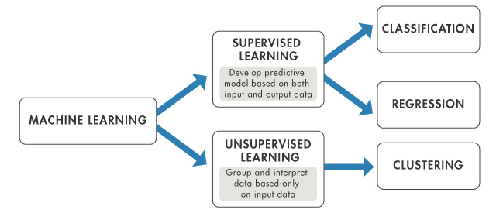
PROBLEM DESCRIPTION

Slide 30
PROBLEM DESCRIPTION

Slide 31
PROBLEM DESCRIPTION

Slide 32
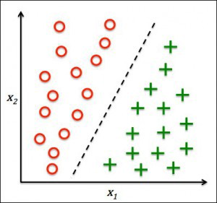
CLASSIFICATION
Class:
+, O (y)
Features:
x₁, x₂ (X)

Slide 33
CLASSIFICATION
Classifier:
y = f(x₁, x₂)
Class:
+, O (y)
Features:
x₁, x₂ (X)

Slide 34
CLASSIFICATION
Classifier:
y = f(x₁, x₂)
Class:
+, O (y)
Some classifiers you might know:
Logistic regression
Support vector machine
Decision trees
Features:
x₁, x₂ (X)

Slide 35
Artificial NEURON
The artificial neuron accepts feature values from the input layer…
Input Layer
x₁
x₂
c
Features

Slide 36

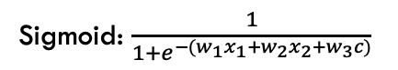
Artificial NEURON
…computes a single output from an activation function applied to a weighted sum of inputs (e.g. sigmoid)…
Input Layer
Activation Function
x₁
w₁₁
x₂
w₂₁
c
w₃₁
Features
Sigmoid: $\frac{1}{1+e^{−(w_{1}x_{1}+w_{2}x_{2}+w_{3}c)}}$

Slide 37
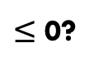
Artificial NEURON
…and classifies data based on a threshold value (or a max function in multi-class problems).
Input Layer
Activation Function
Output
x₁
w₁₁
+
> 0?
x₂
w₂₁
O
c
$≤$ 0?
w₃₁
Features
Sigmoid: $\frac{1}{1+e^{−(w_{1}x_{1}+w_{2}x_{2}+w_{3}c)}}$
Predicted Class

Slide 38
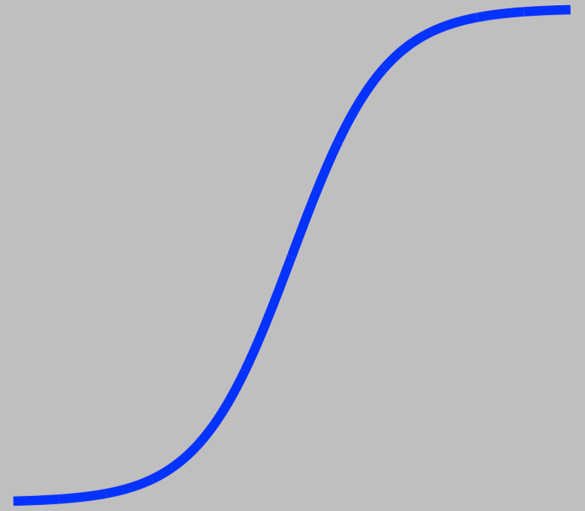

Neural network
A neural net stacks artificial neurons in layers to fit more complicated nonlinear classification functions:
f₁₁
w₂₁₁
f₂₁
+
x₁
w₁₁₁
w₃₁₁
f_{out} > 0
w₂₁₂
w₁₁₂
w₁₂₁
w₂₂₁
x₂
f₁₂
w₂₂₂
f₂₂
w₃₂₁
f_{out}
w₁₂₂
O
w₁₃₁
w₂₃₁
w₃₃₁
c
c₁
c₂
w₁₃₂
w₂₃₂
f_{out}$≤$ 0
Input Layer
Hidden Layer 1
Hidden Layer 2
Output
Layer

Slide 39
FINDING WEIGHTS VIA BACKPROPAGATION
A neural network is a combination of architecture and weights. Backpropagation finds weights minimizing prediction loss using two alternating steps:
Feedforward: predict classes for a batch of examples, compute loss
Adjust weights layer by layer, starting with the deepest layer, to decrease loss using activation gradients

Slide 40

FEEDFORWARD STEP

Slide 41
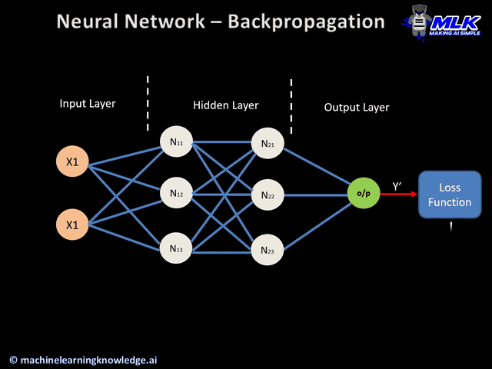
BACKPROPAGATION STEP

Slide 42
BACKPROPAGATION STEP
Backprop computes gradients of the loss function through successive layers. We want the gradients to be zero to minimize loss => found (locally) optimal weights.
The choices of activation function and optimizer have significant impacts on backprop’s convergence.

Slide 43
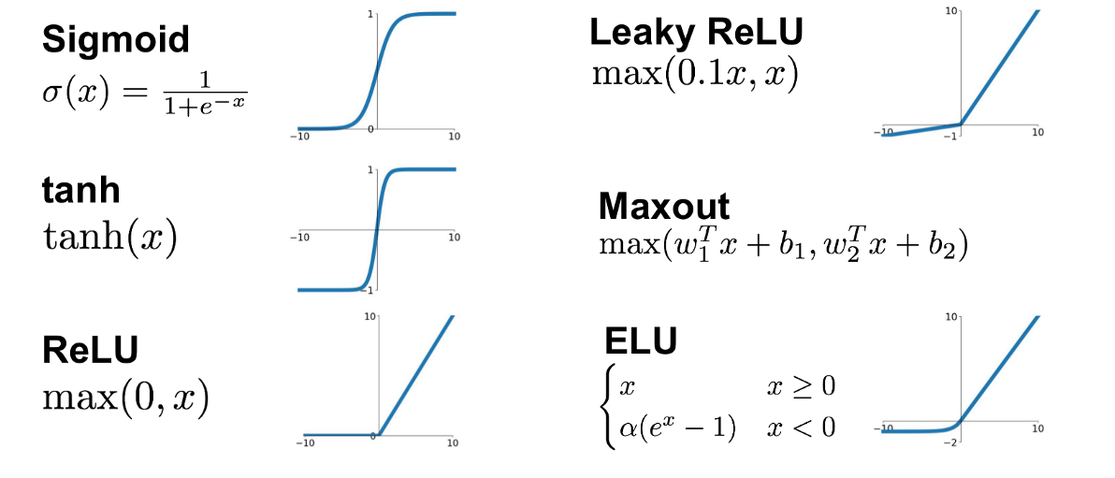
ACTIVATION FUNCTIONS
Vanishing gradient problem: with many layers, loss gradient goes to 0 => slow or no training. Useful in output layer.
More parameters and non-sparse. Try if ReLU is problematic.
Dying ReLU: large changes can cause neuron never to activate again.
Exploding gradient: large changes cause instability, leading to failure to train.

Slide 44
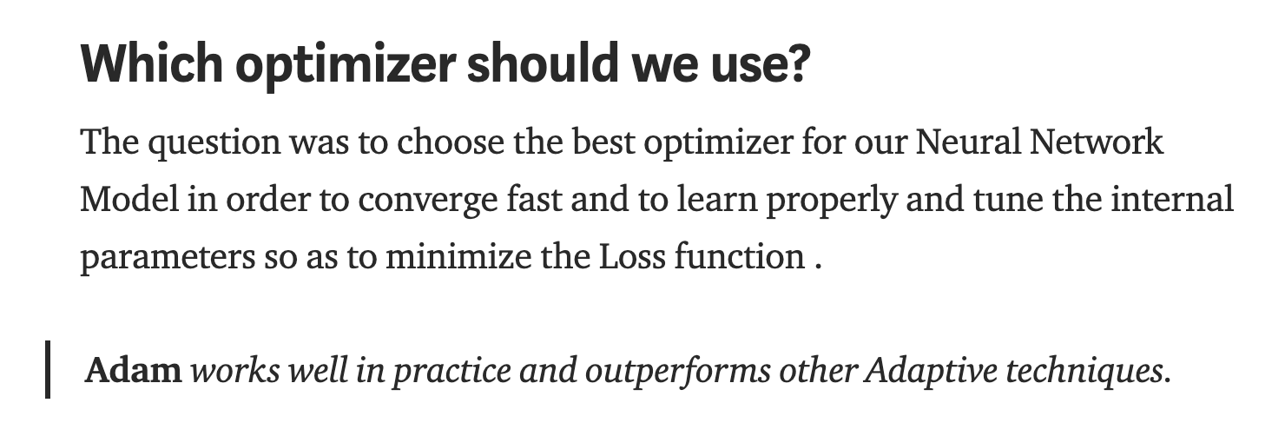
OPTIMIZERS
Description is complicated and beyond scope.
If you are curious about optimizers, check out https://towardsdatascience.com/types-of-optimization-algorithms-used-in-neural-networks-and-ways-to-optimize-gradient-95ae5d39529f

Slide 45
DEEP NEURAL NETWORKS
A deep neural network is a neural network with numerous layers, introducing a variety of mathematical and computational challenges:
Training routines need to be efficient
Writing out hundreds of layers of linear algebra sucks
Need to rewrite for every new model architecture (!)
Model portability

Slide 46
TensorFlow…
is an open source ML utility developed by Google Brain, originally built to make DL available across the Google org
v1.0 released Feb 2017
v2.0 released Sep 2019
offers application protocol interfaces (API) for several languages, esp. Python, C++
makes deep learning implementation less painful, customizable, and portable

Slide 47
DATA AS TENSORS
As it pertains to deep learning, a tensor is a (potentially) multidimensional array:
0D tensor
(scalar)
1D tensor
(col/row vector)
2D tensor
(matrix)
No dimensions
(2)
(2,3)

Slide 48


DATA AS TENSORS
3D tensor
4D tensor
(2,3,3)
(2,3,3,2)
1
2
3
1
2
3
1
2
3
1
2
3
1
2
3
1
2
3
1
2
3
1
2
3
7
8
9
1
2
3
1
2
3
1
2
3
1
2
3
1
2
3
1
2
3
4
5
6
4
5
6
10
11
12
X coordinate
Y coordinate
Channel value (RGB)
X coordinate
Y coordinate
Channel value (RGB)
Frame

Slide 49
FLOW OF TENSOR OPERATIONS
The result of a tensor operation is again a tensor:
1
2
3
1
2
3
1
2
3
1
2
3
4
5
6
1
2
3
4
5
6
2
4
6
4
5
6
+
1
2
3
1
2
3
8
10
12
1
2
3
1
2
3
1
2
3
4
5
6
4
5
6
4
5
6

Slide 50

FLOW OF TENSOR OPERATIONS
The flow of data, tensor to tensor, is represented in a computational graph that efficiently encodes the operations to train a neural network.

Slide 51
Keras…
is a TensorFlow API (+ Theano, CNTK) for neural networks, written in Python
offers rapid model prototyping – as straightforward as building with Lego bricks
is integrated directly into TensorFlow 2.0
trades a little control away in favor of clarity and intuitiveness
can still use TensorFlow toolbox where control is needed!
“Being able to go from idea to result with the least possible delay is key to doing good research.”
~ keras.io

Slide 52
Google Colaboratory…
is a cloud environment for writing and running Jupyter Notebooks in your web browser, for free, for educational purposes
provides access to graphics and tensor processing units to speed model training
offers a nice, uniform environment for this workshop – let’s check it out now

Slide 53
Go to https://colab.research.google.com/
Select File > Open notebook
Click GitHub, search allemanau
Ensure the “NUIT_tensorflow” repository is selected
Open “1_Colab_Python_and_TensorFlow.ipynb”

Slide 54

2D Tensor
1D Tensor
Hidden
(ReLU)
Output
(Softmax)
(28, 28)
(740, )
(200, )
(10, )
255
…
1
0
0
199
0
2
0
…
1
0
0
2
3
2
1
…
…
0
…
0
9
0
100
0
…
200
188
0
255

Slide 55
Flatten
Dense
ReLU
Dense
Softmax
1Hot
(28, 28)
(740, )
(200, )
(200, )
(10, )
(10, )
(10, )
255
0
.03
0
…
1
X₁
1
.01
0
2
.01
0
199
2
X₂
…
3
.05
0
4
.01
0
2
3
X₃
5
.83
1
…
…
…
6
.02
0
100
7
.01
0
…
200
X₂₀₀
8
.05
0
188
9
.01
0
0
255

Slide 56
Flatten
Dense
ReLU
Dense
Softmax
1Hot
(28, 28)
(784, )
(128, )
(128, )
(10, )
(10, )
(10, )
255
0
.03
0
…
1
X₁
1
.01
0
2
.01
0
199
2
X₂
…
3
.05
0
4
.01
0
2
3
X₃
5
.83
1
…
…
…
6
.02
0
100
7
.01
0
…
128
X₁₂₈
8
.05
0
188
9
.01
0
0
255

Slide 57
0
1
2
2
2
0
0
1
2

Slide 58
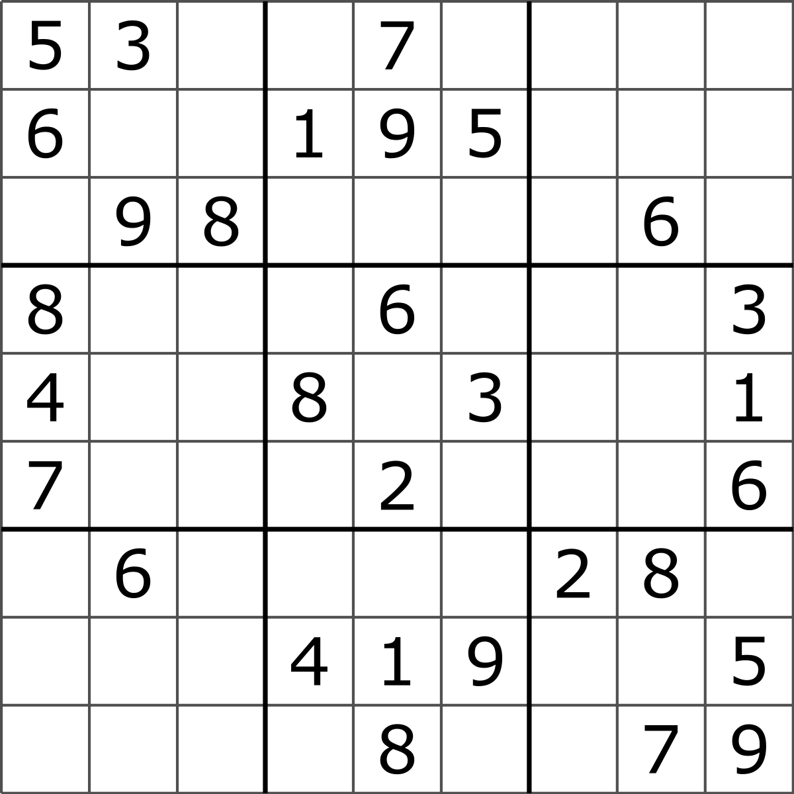
ORIGINS OF “DEEP LEARNING”
Rina Dechter, 1986, on extracting all information from dead-ends to solve constraint-satisfaction problems:
“…such deep learning may require a considerable amount of work.”
A constraint-satisfaction problem.

Slide 59
ORIGINS OF “DEEP LEARNING”
BLANK

Slide 60
ORIGINS OF “DEEP LEARNING”
BLANK
1
1
2
3
…
9

Slide 61

ORIGINS OF “DEEP LEARNING”
BLANK
1
1
2
3
…
9
ALL WRONG ANSWERS

Slide 62
ORIGINS OF “DEEP LEARNING”
BLANK
1
1
2
3
…
9
ALL WRONG ANSWERS
ALL WRONG ANSWERS
ALL WRONG ANSWERS
ONE OF THESE IS RIGHT!
Deep in a tree of possibilities.

Slide 63
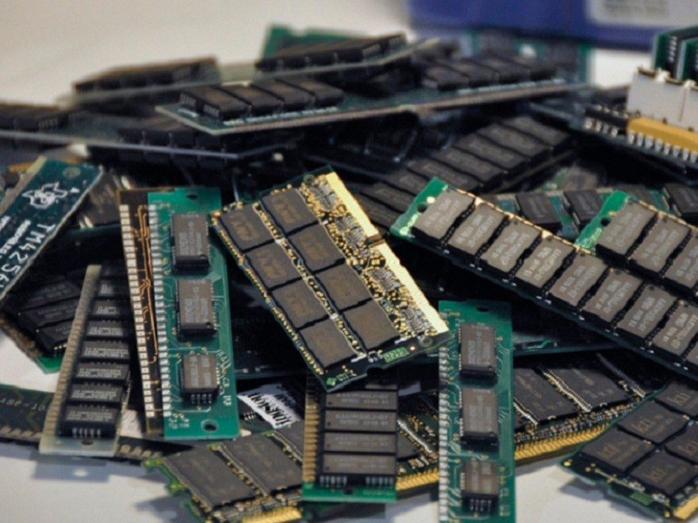
ORIGINS OF “DEEP LEARNING”
Igor Aizenberg, 2000:
“…learning tasks that require deep use of memory, i.e. memory spanning hundreds or thousands of inputs.”
Lots of physical memory is necessary.
Deep in a vast space of possible neural network models.

Slide 64
WHAT IS DEEP LEARNING?
Extremely flexible and scalable learning technique
An old idea undergoing an Information Age renaissance
Gold standard for high-dimensional and big data problems
Super hot area of research and desirable job market skill

Slide 65
